Slide 1
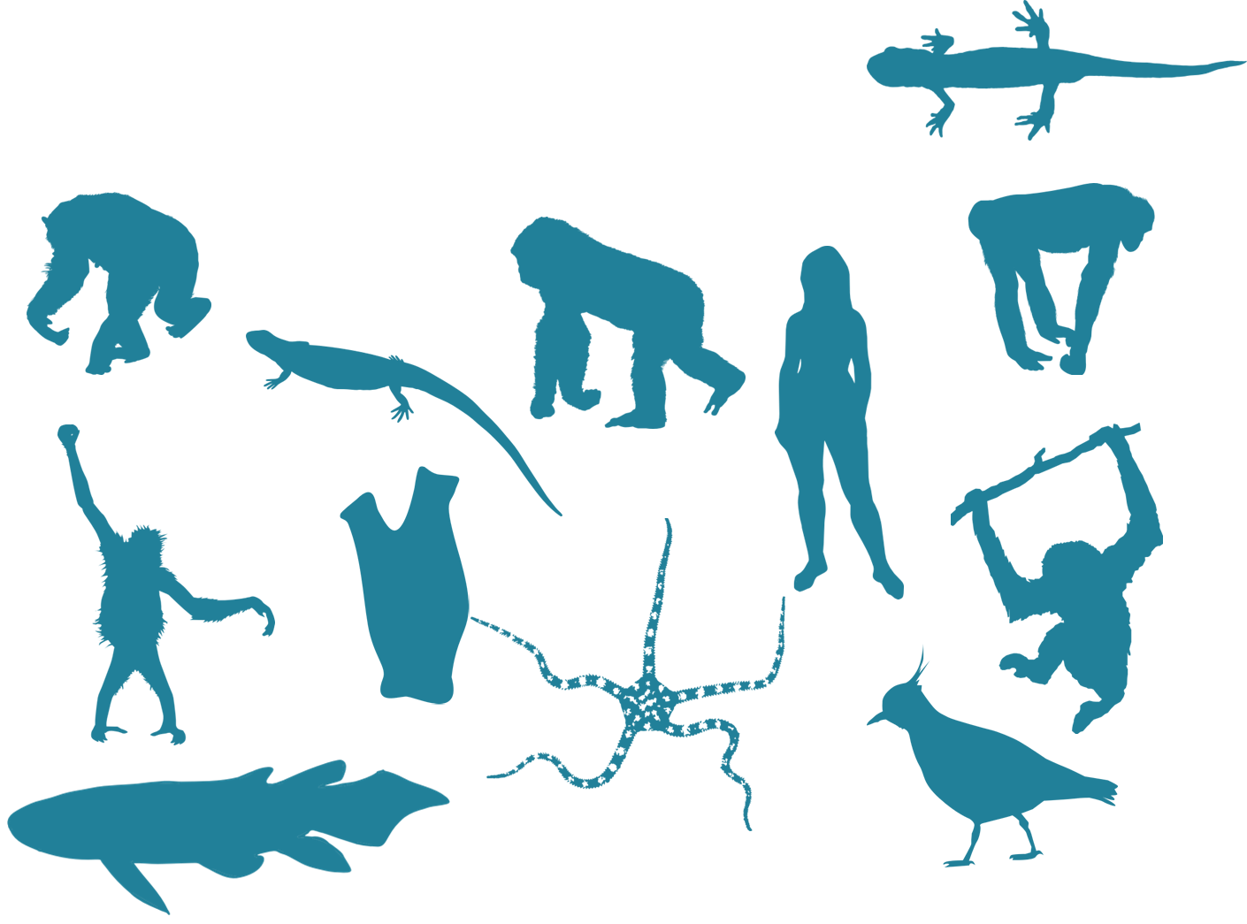
Going backwards-
Inferring phylogeny

Slide 2
How many possible trees for 4 taxa?

Slide 3
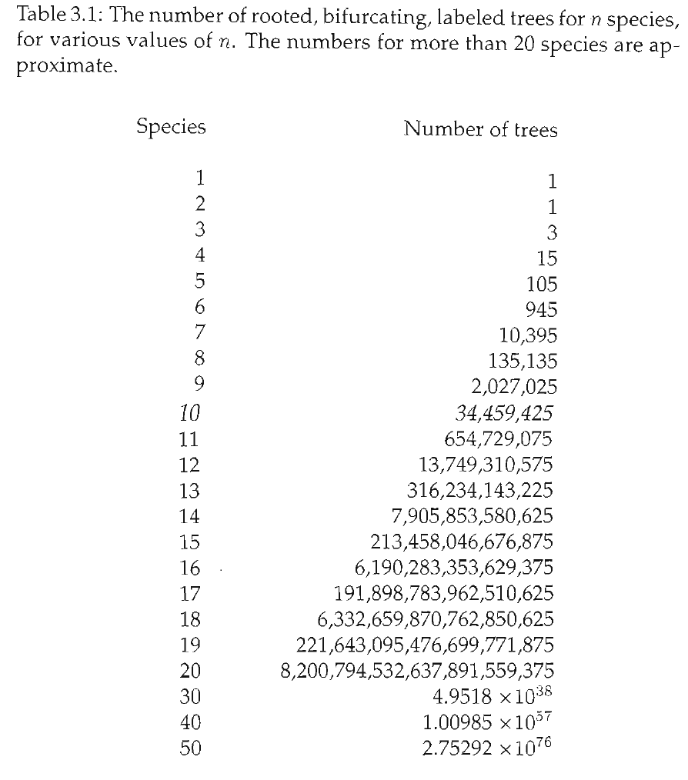
Tree space is huge!! = Estimating phylogeny is a very hard problem

Slide 4
How can we find the “true” tree? (Is there a true tree?!?)

Slide 5
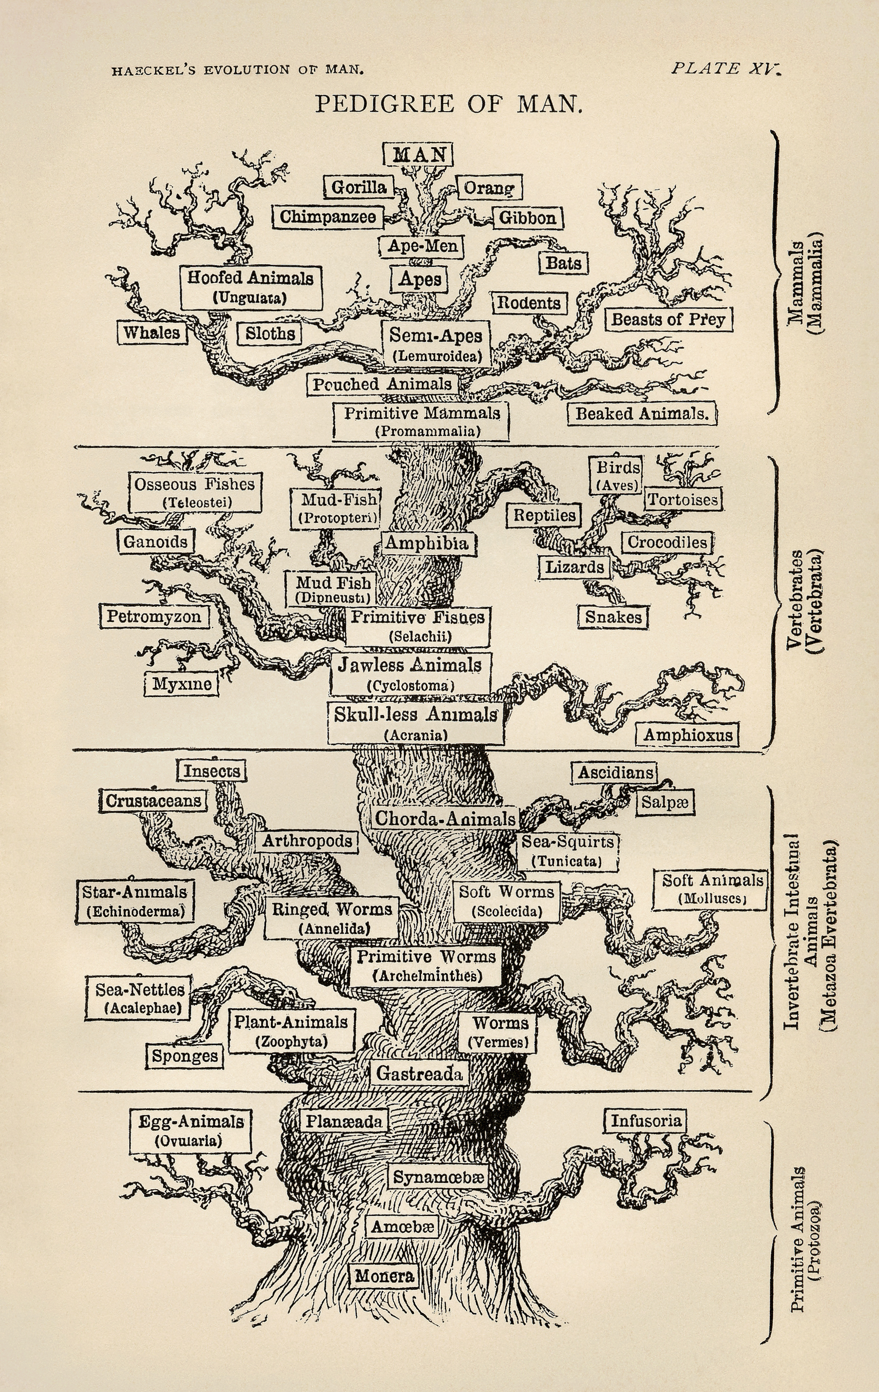
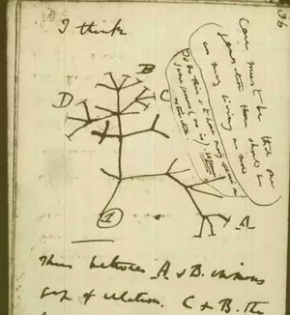
History of phylogenetic inference

Slide 6

History of phylogenetic inference
Evolutionary Taxonomy
Phenetics
Cladistics
Statistical Phylogenetics

Slide 7
History of phylogenetic inference: Evolutionary Taxonomy
No objective methodology
Relies on expert opinion & a lifetime of study

Slide 8
History of phylogenetic inference: Phenetics
Numerical Taxonomy & distance methods - measure overall similarity
How do you measure similarity?
What are the drawbacks of this approach?
Sokal, Sneath & Rohlf (1960's) argued phenetics provided much needed reproducibility

Slide 9
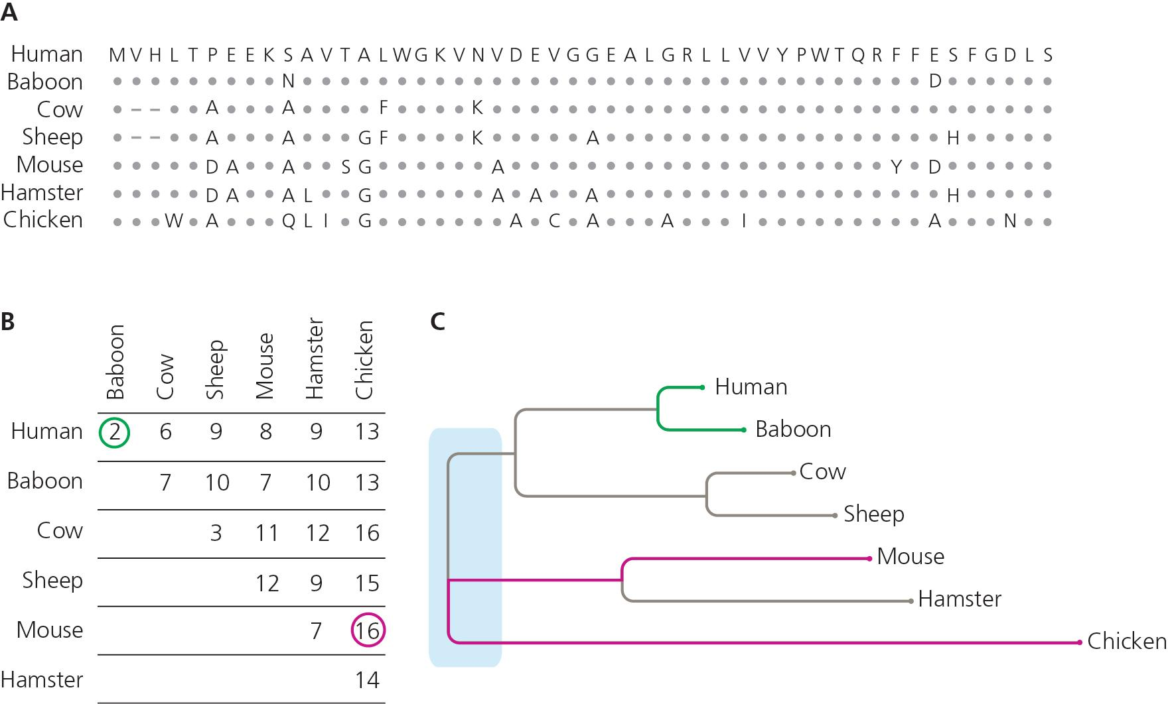

Slide 10
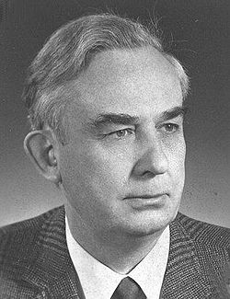
History of phylogenetic inference: Cladistics
"Phylogenetic systematics"
Argued that grouping should not be based on overall trait similarity, but only on shared derived traits (synapomorphies)
Taxonomy based on monophyly
Parsimony & Occam's Razor- The simplest explanation is probably the correct one
Willi Hennig (1966)

Slide 11
Phenogram
Cladogram

Slide 12

What’s the phylogenetic relationship?

Slide 13
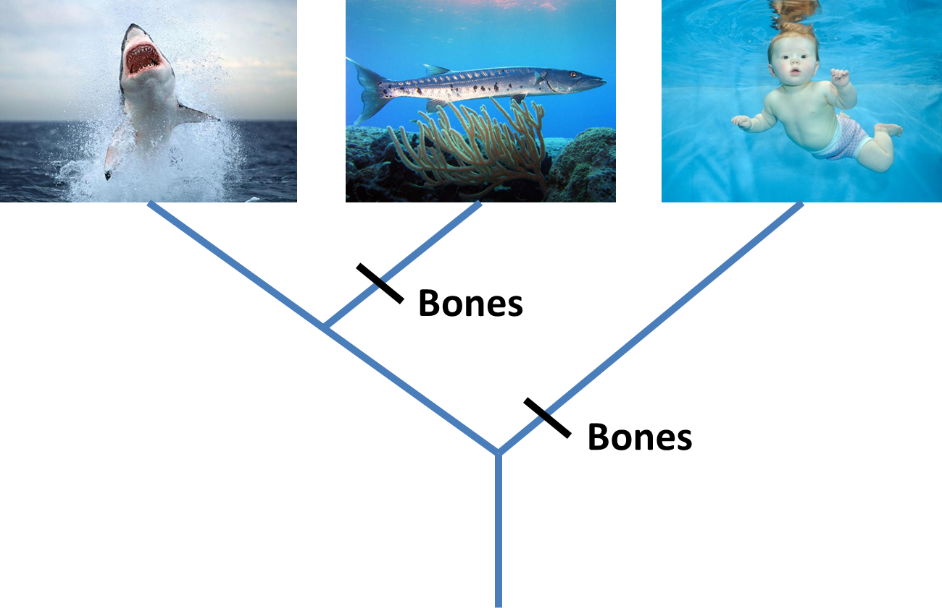

Slide 14
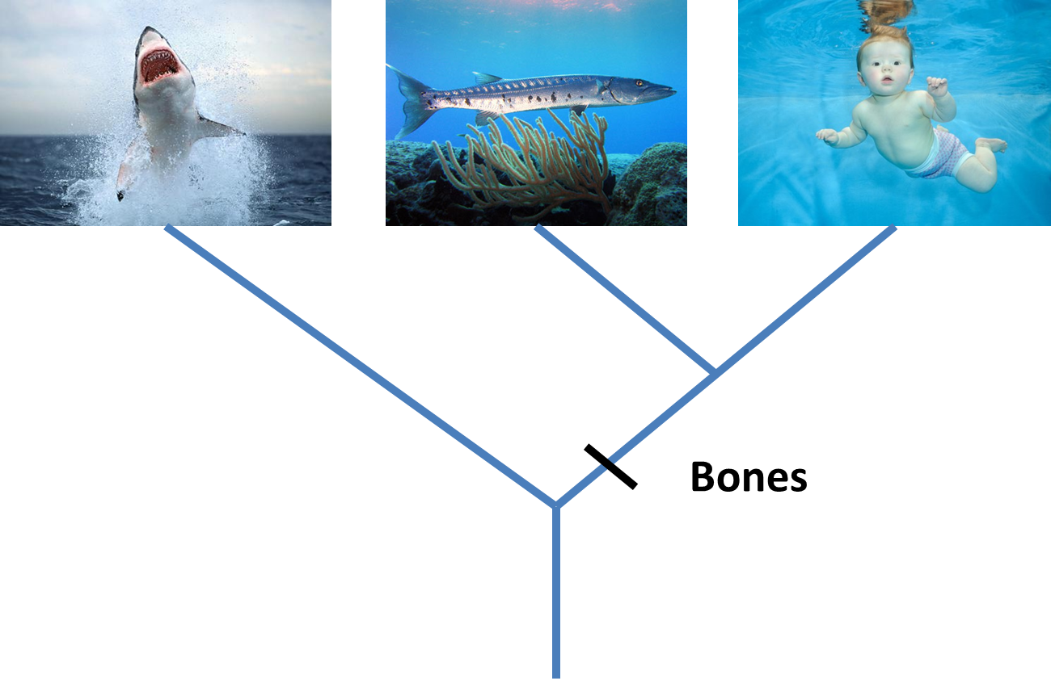
Parsimony

Slide 15
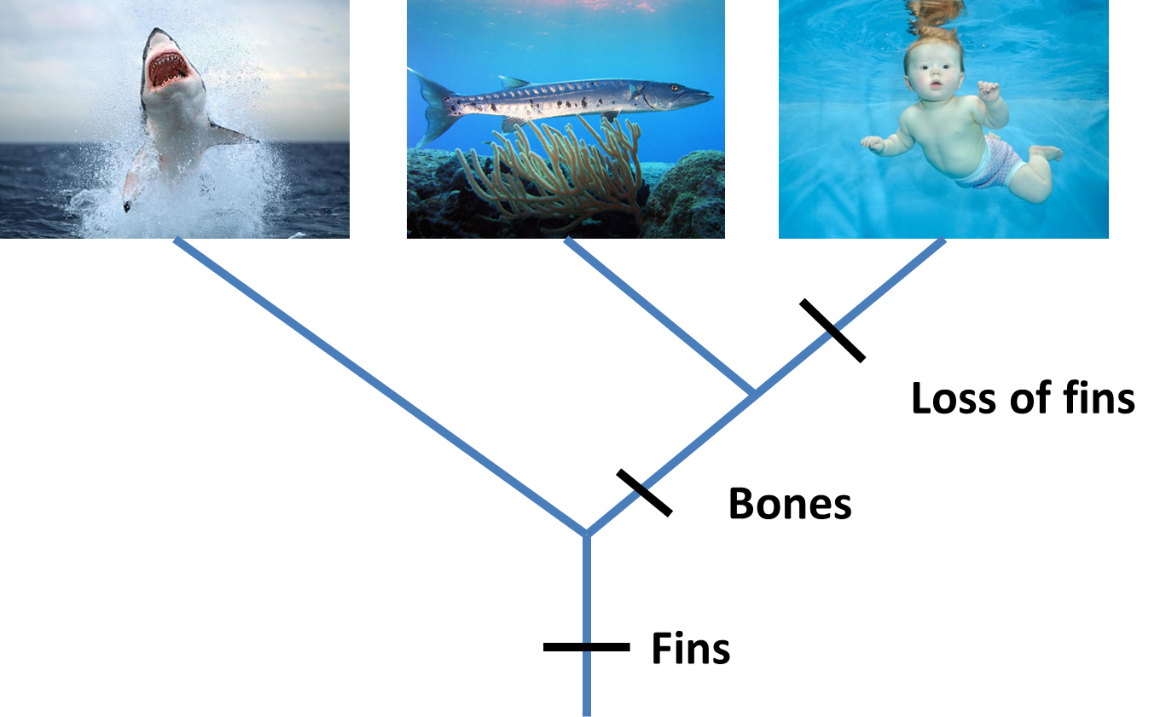

Slide 16
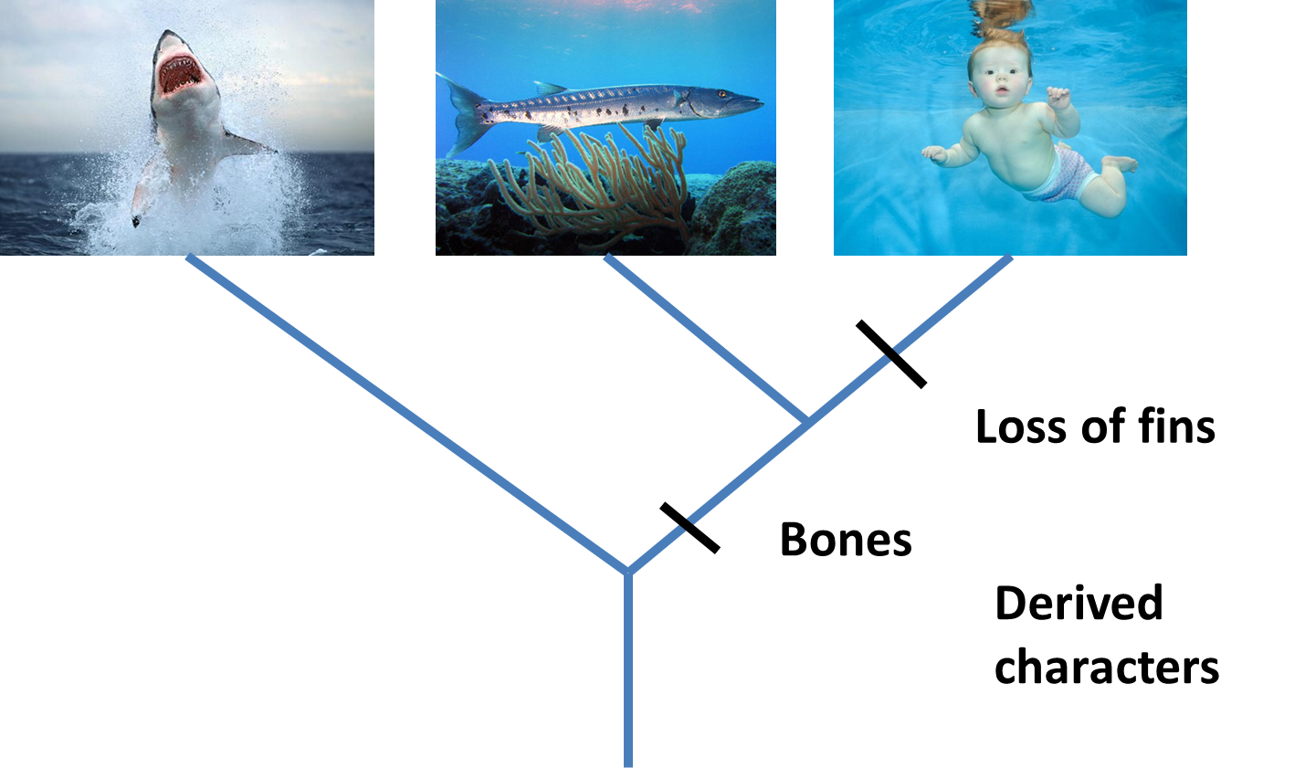
Derived Characters = Apomorphies

Slide 17
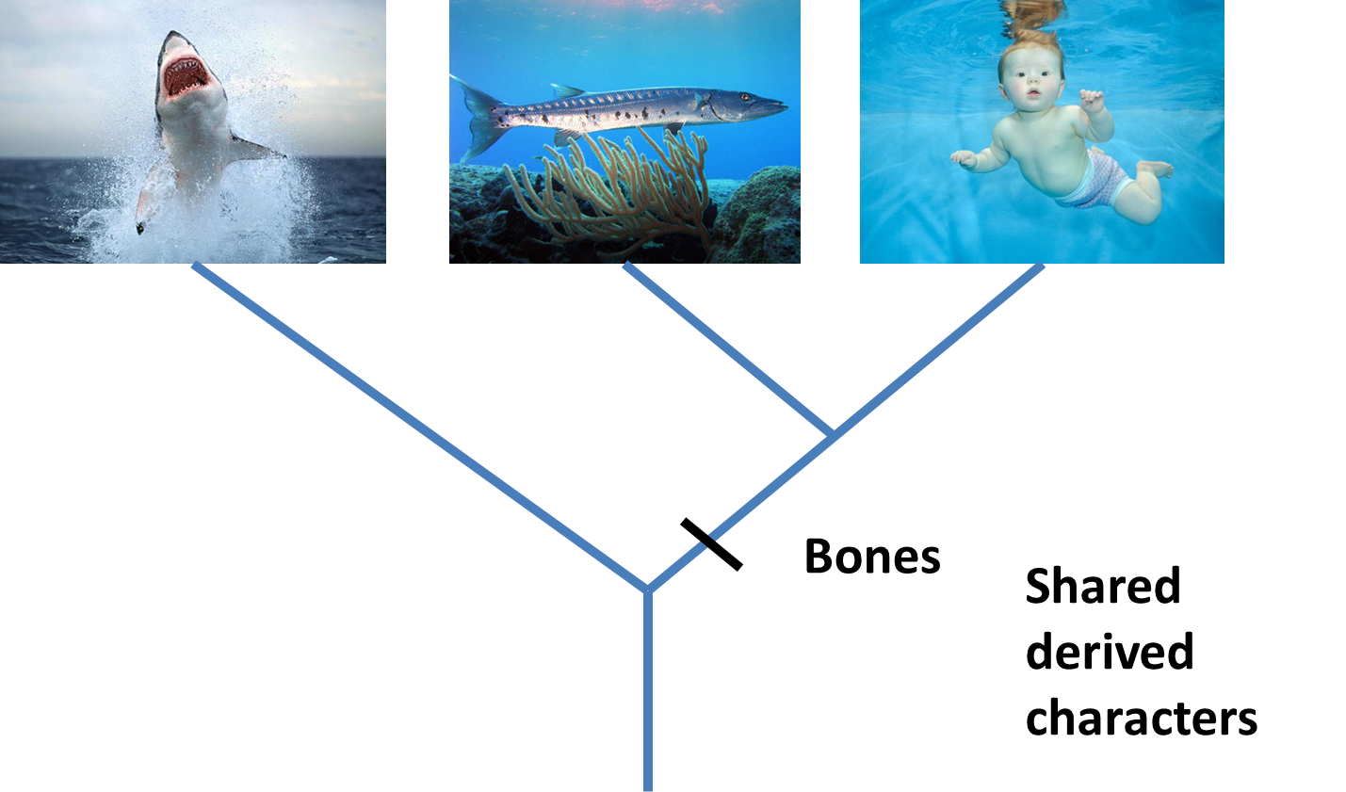
Shared derived characters = Synapomorphies

Slide 18

Shared ancestral characters = Symplesiomorphies

Slide 19
Overall similarity takes all characters equally
Cladistics only considers synapomorphies, and excludes autapomorphies & symplesiomorphies
Best supported hypothesis: Minimizing # of steps
Critical role of outgroup to distinguish derived vs. ancestral characters
Also note that characters are defined as derived/ancestral relative to the taxa being considered (the ingroup)

Slide 20
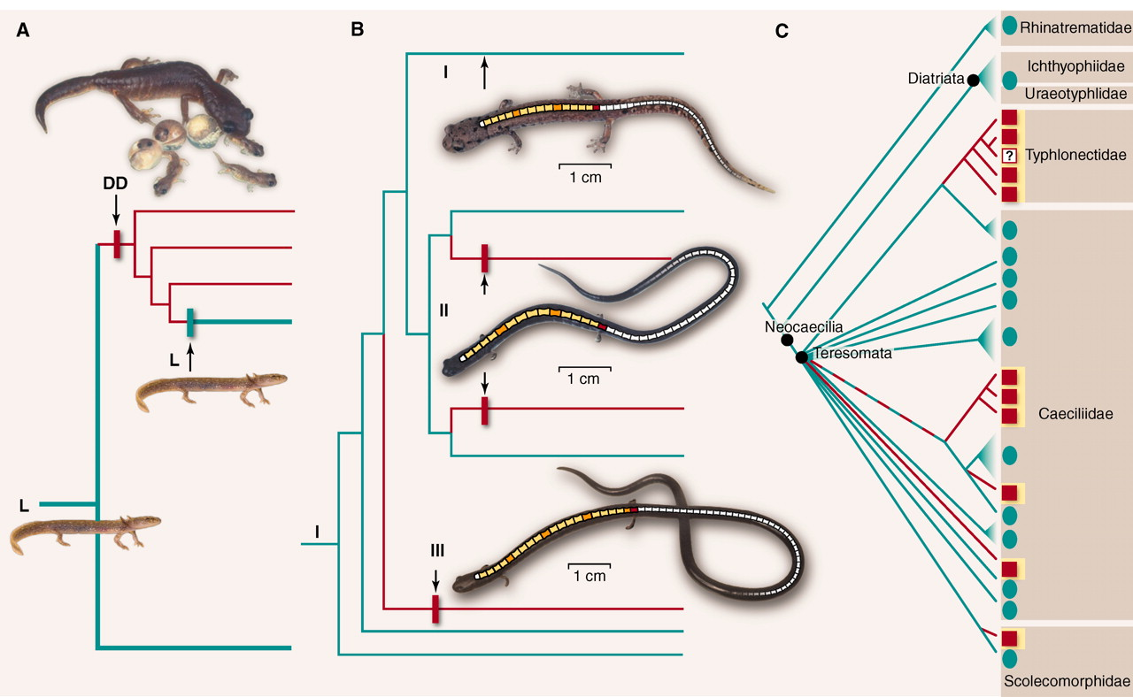
Conflict = Homoplasy Evolutionary reversals and/or convergence

Slide 21
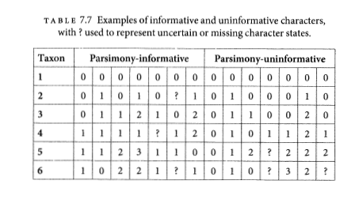
Parsimony informative vs. uninformative
Must have at least 2 taxa with shared traits in 2 different states.
Characters

Slide 22
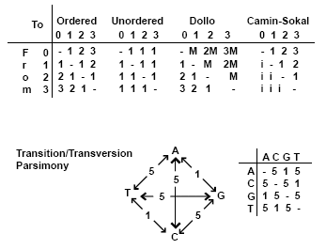
Generalized Parsimony
Step matrices
By Peter Forey https://www.palass.org/publications/newsletter/cladistics-palaeontologists/cladistics-palaeontologists-part-4-optimisation

Slide 23
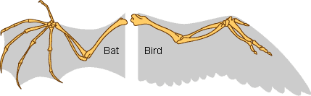
Homology
Primary homology - Initial hypothesis of homology due to similarity
Secondary homology - Implied homology single origin on phylogeny by parsimony analysis
Underlines importance of character construction - often surprisingly subjective
“Reciprocal illumination” Hennig 1966

Slide 24
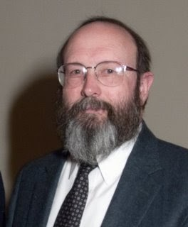
History of phylogenetic inference: Statistical phylogenetics
Luca Cavalli-Sforza, Anthony Edwards and later, Joseph Felsenstein
Probabilistic models of trait evolution
Showed statistical issues with parsimony, e.g. "the Felsenstein zone"
Maximum Likelihood & Bayesian inference
Joe Felsenstein

Slide 25
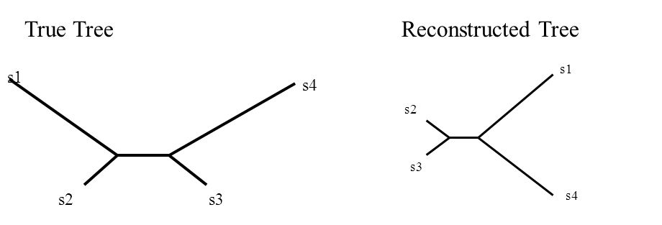
The Felsenstein Zone & "Long-branch attraction"
More generally, parsimony fell out of favor for molecular data due to more flexibility in incorporating substition models in statistical phylogenetics

Slide 26
My oversimplification of the problem...
Under the cladistics philosophy (model), homoplasy is a “mistake” in character construction
Coding independently evolved traits the same, look closer and you'll see they're different!! (e.g. wings of birds & wings of bats)
But for DNA, complete convergence is real (a “T” is a “T” is a “T”, no matter how it became that)
As similarity by convergence becomes more common than similarity by shared ancestry, parsimony fails, and no “looking closer” at the character will save it.

Slide 27
Parsimony main assumption “Occam's Razor” has unclear implications for what this means for the assumed evolutionary process Ultimately -> rare changes or "no common mechanism" (Tuffley and Steele 1997)
Inconsistent estimator - An estimator that gets more and more certain of the wrong answer as more data is added

Slide 28
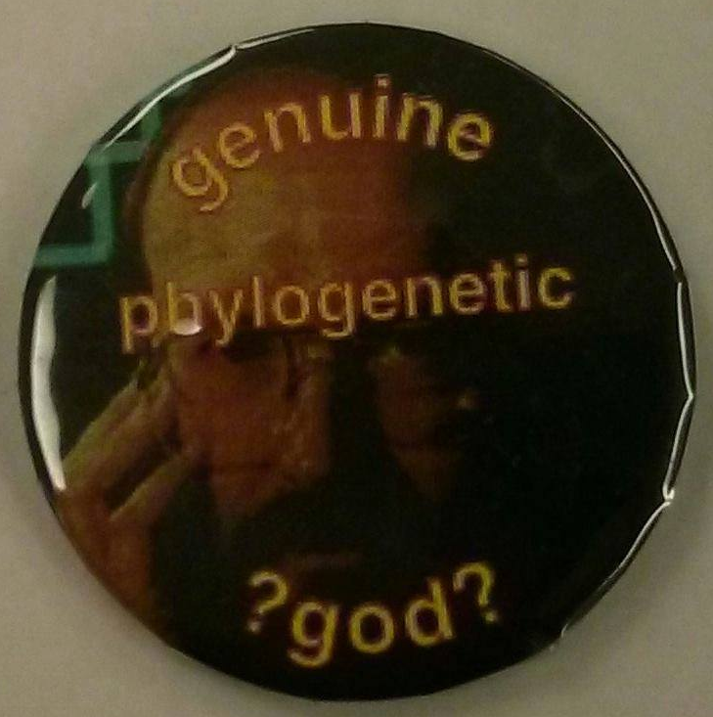
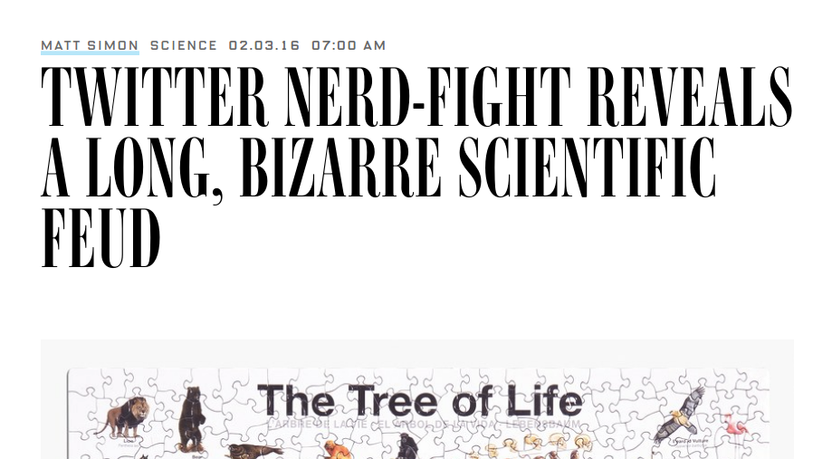
Conflict in science
#ParsimonyGate

Slide 29
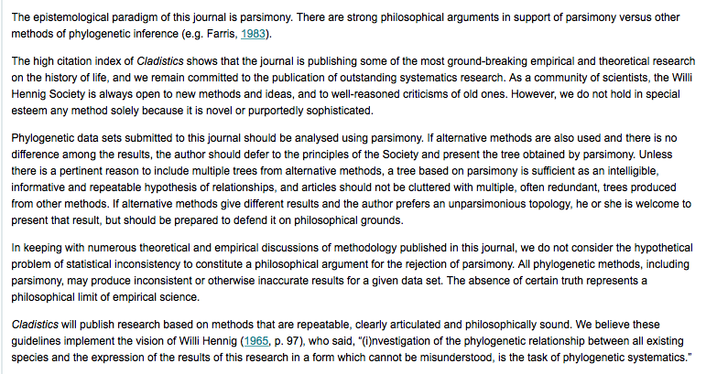

Slide 30
Parsimony still commonly used for:
Morphological analyses (though probabilistic models exist here too)
Starting trees
Understanding history of trait change

Slide 31
Practical considerations

Slide 32
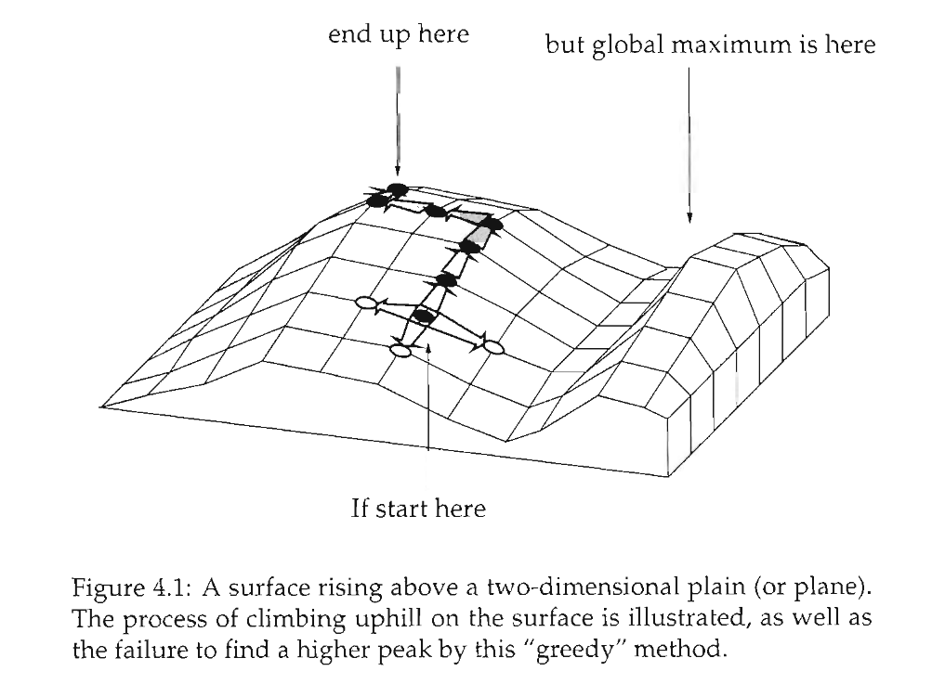
Heuristic searches

Slide 33
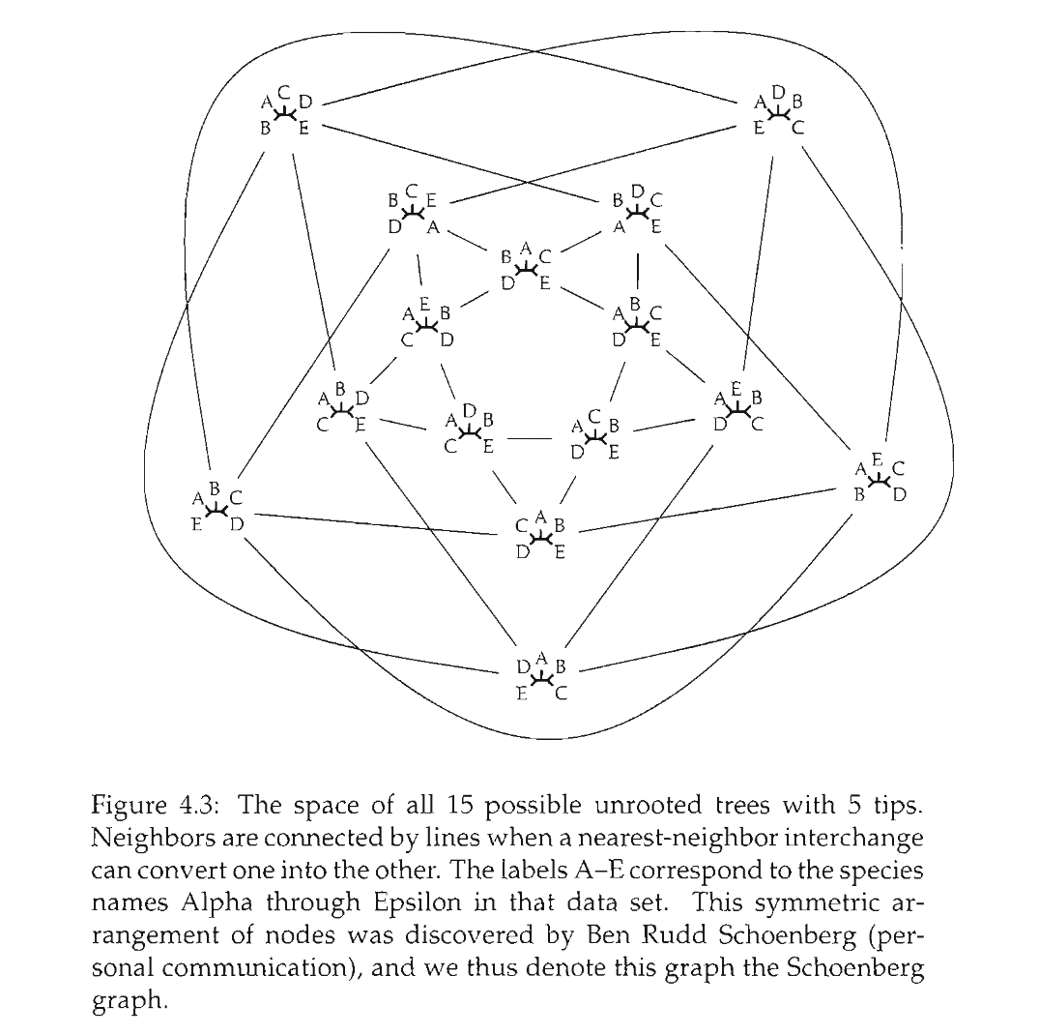

Slide 34
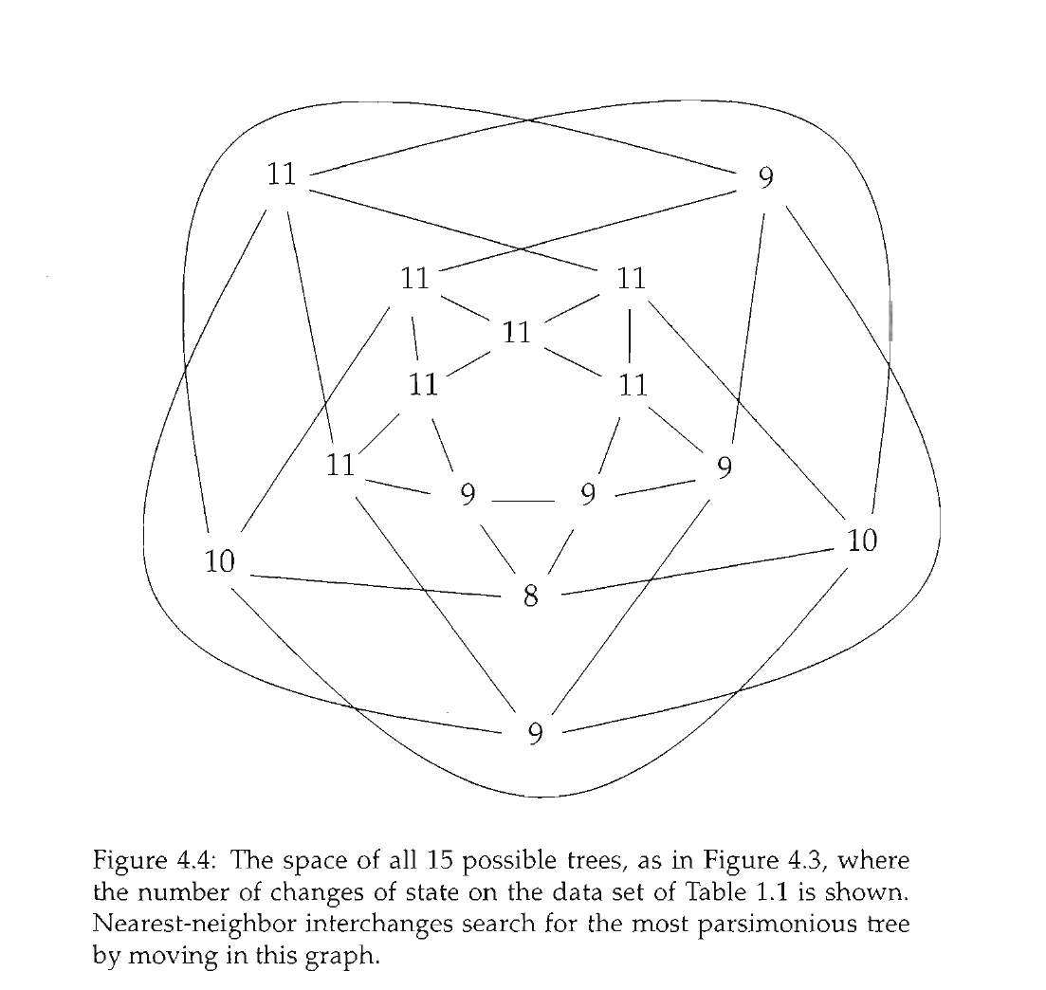

Slide 35
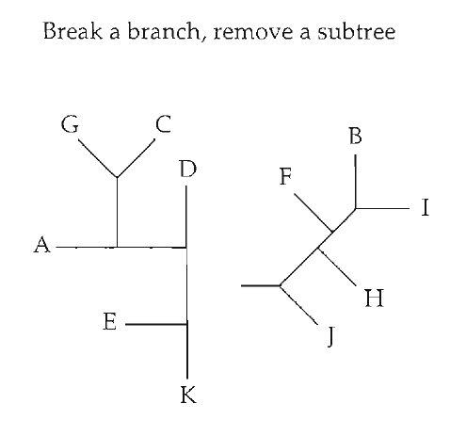
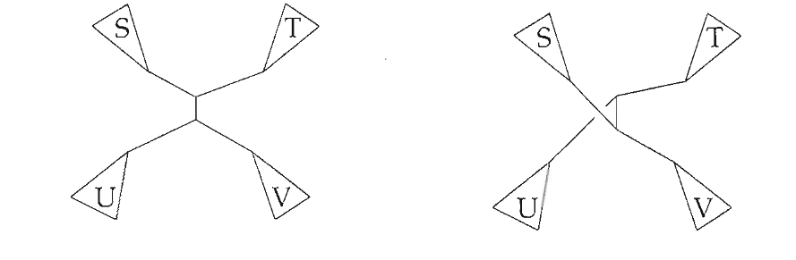
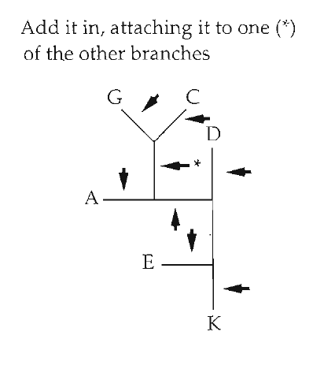
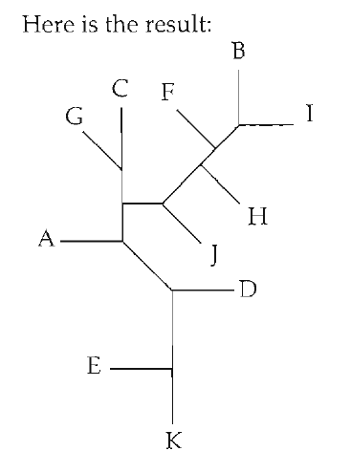
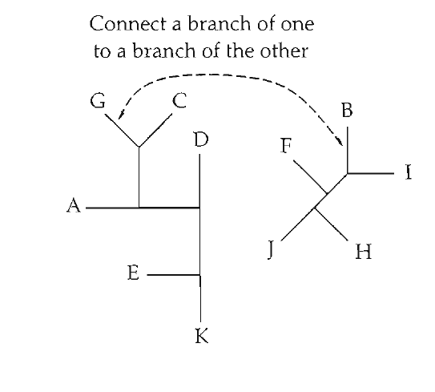
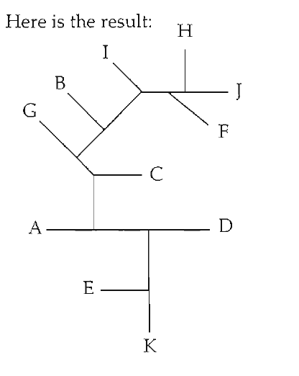
Tree space "moves"
Nearest Neighbor Interchange (NNI)
Tree bisection and reconnection (TBR)
Subtree pruning and regrafting (SPR)

Slide 36
Distance between tree spaces changes depending on which moves you use
NNI fastest, least computationally intensive, but the largest distances between trees
TBR slowest, most computnationally intensive, but shortest distances between trees
SPR intermediate

Slide 37
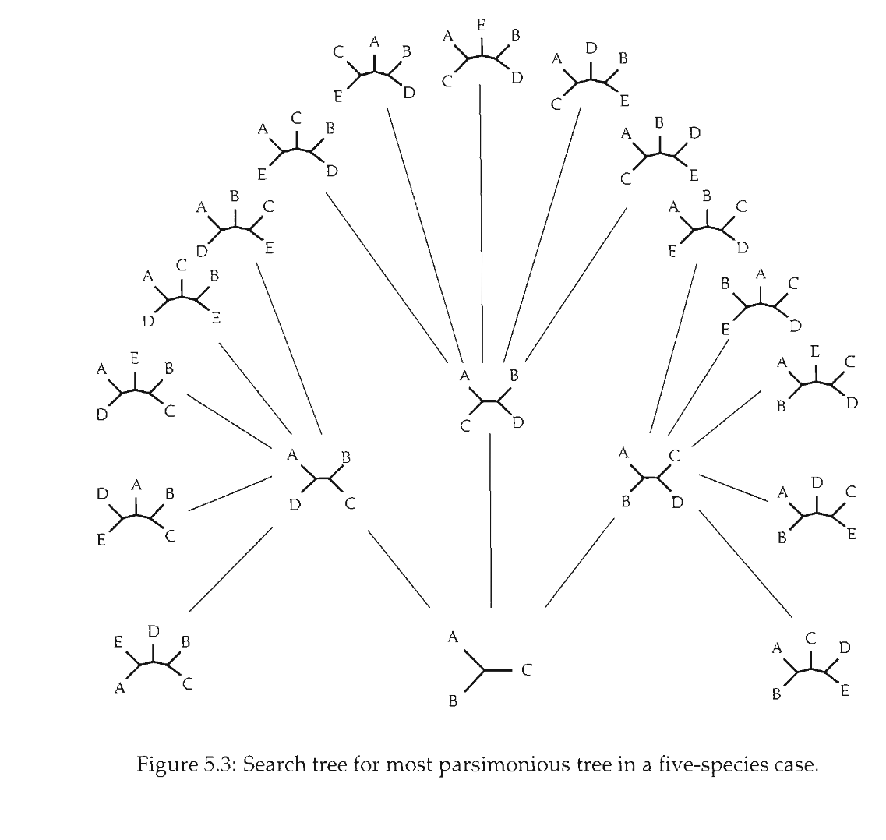
Branch and bound

Slide 38
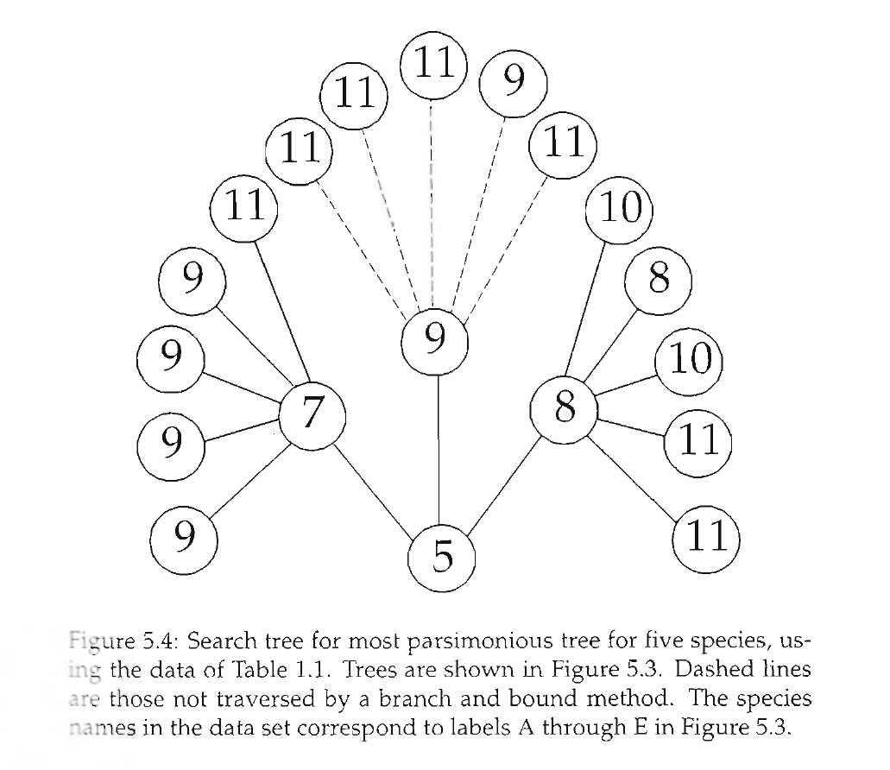
Branch and bound

Slide 39
Software: PAUP*, TNT, Mesquite, others...

